Slide 1



Introduction & Web foundations
By Elham Jaffar

Slide 2
Vconnect Rules
We will start at 8:00 pm from now on
Video is encouraged
Keep you mic muted please
Raise your hand if you have a question or want to talk in general
Please try to engage as much as possible so we make the most out of the session

Slide 3
Elham Jaffar
Bachelor Degree in Information Technology & Computing – AOU
Master’s Degree in Software Engineering – SJU
A programmer since 2008
Currently, I work as an Application Analyst – JHAH
Udacity Session Lead FEND & IPND – Dammam Branch

Slide 4
Why connect?
Motivational progress
Working together and building a community
Accelerated program

Slide 5

Let’s get to know each other
What is your name?
What do you do?
Why have you joined FEND program?
What is your interest?

Slide 6

Slack
What is Slack?
Briefly it is students online community.
Let’s Register
Use Udacity Email
http://bit.ly/2IdU6GU
#General
#FEND
#FEND_VConnect_2

Slide 7

Plagiarism
Udacity uses plagiarism checker
Give credit if someone helps you
It's important to cite sources you used

Slide 8

Main objective of FEND
HTML
Layouts
CSS – Style your website
Responsive
User Friendly
Object Oriented Java Script
Interactive websites
How to solve problems
Optimizing websites
APIs and Different frameworks
New tools and technologies
Testing
AND MORE !!!!!

Slide 9
syllabus
Web Foundations
L1: Animal Trading Cards
P1: Building a Portfolio Site
Web Programming with JavaScript
L2: Pixel Art Maker
P2: Memory Game
Exploring JS – Objects, Tools and Testing
P3: Classic Arcade Game
P4: Feed Reader Testing
Front-End Applications
P5: Restaurant Review App
Building with React
P6: MyReads – A Book Tracking App
P7: Neighborhood Map (React)
Schedule

Slide 10



tools
Code Editor
Atom Sublime
Browser
Google Chrome

Slide 11
Setting up
Open your text editor
Write (Let’s learn code <b> today ! </b>)
Save as (firstExercise.html)
Open the file by using Google chrome

Slide 12
Think like a programmer
1
2
3
Procedural Thinking
Clear instruction for a computer to follow
Abstract Thinking
Finding Similarity to avoid repetition of work
System Thinking
Break system down to small pieces & plan
4
5
Technological Empathy
Ability to understand how computer works (like html code)
Debugging
Finding the cause of the failures and fix it

Slide 13



Major Pieces
INTERNET
HTTP
(Hyper Text Transfer Protocol)
USER
WEB/BROWSER
SERVER

Slide 14

WWW
The World Wide Web (abbreviated WWW or the Web) is an information space where documents and other web resources are identified by Uniform Resource Locators (URLs)
Founded by Tim Berners-Lee in 1990s & today has 30 billion pages.

Slide 15
HTML
What does HTML stand for?
Hypertext
Markup
Language
It is the standard markup language for creating web pages and web applications.

Slide 16
HTML Element
Attribute
<tag attr =“value”>
Content
</tag>
Opening
Closing
What will happen if you forget to close the element ?
Element

Slide 17
Type of element
A block-level element always starts on a new line and takes up the full width available (stretches out to the left and right as far as it can).
Paragraph: <p> </p>
Division: <div> </div>
An inline element does not start on a new line and only takes up as much width as necessary.
Bold: <b> </b> Strong: <strong></strong> .. What is the difference ?
Emphasize: <em> </em>
Span: <span> </span>
Anchor: <a></a> href attribute
Image: <img> src and alt attributes
New Line: <br>

Slide 18
Image & Anchor Tags
Image: <img src=“imageName.jpg” alt=“description”>
Link: <a href=“www.google.com” target=“_blank”> Google </a>
No closing tag
Always add alt
Set a target as a blank to open a new page

Slide 19
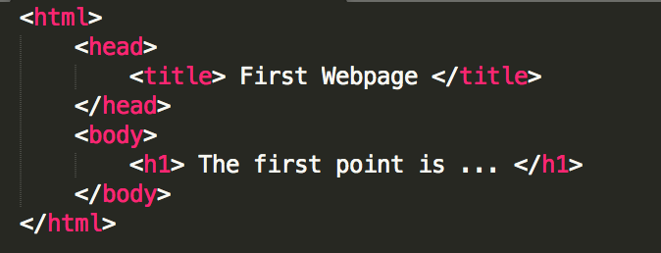
HTML Structure
Indentation is Important
Write a good and organized code that other people can read

Slide 20
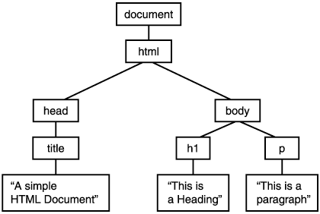
Html Dom
It presents a HTML document as a tree structure with elements, attributes and texts.

Slide 21

Remember that we are here to help you
All you have to do is ASK!
Thank you for Attending

